Slide 1
Microprocessor

Slide 2
8086 Microprocessor
From Intel, produced in 1978
16-bit processor
ALU, Registers and Instructions are designed for 16-bit binary words.
16-bit data bus
Reads data from and writes data to memory and ports at 16 or 8 bits at a time.
20-bit address bus
Can address 2²⁰ or 1,048,576 memory locations, each location is 1 byte.

Slide 3
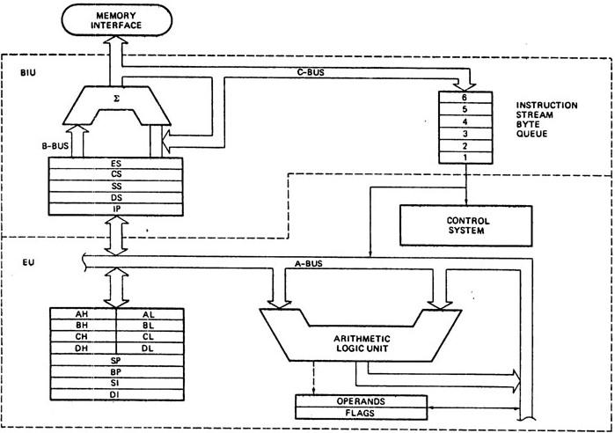
8086 Internal Architecture
Source: http://comptutorkg2pg.blogspot.in/2011/02/8086-microprocessor-internal.html

Slide 4
8086 Architecture (contd.)
Divided into 2 main units
speeds up the operation by working independently
BUS Interface Unit (BIU)
Reads addresses, fetches instructions from memory, reads/writes data from/to memory and ports
Execution Unit (EU)
Tells BIU where to fetch the instructions and data from memory,
Decodes and executes instructions

Slide 5
Execution Unit has
16-bit Arithmetic Logic Unit (ALU)
Control System
Coordinates everything inside a microprocessor
Flag register (16-bit)
A flip-flop to indicate a condition during execution or control some operation
9 flags: 6 conditional (status) and 3 controlling
General-purpose registers
Temporary storage of individual 8-bit data
8 general purpose registers AH, AL, BH, BL, CH, CL, DH, DL.

Slide 6
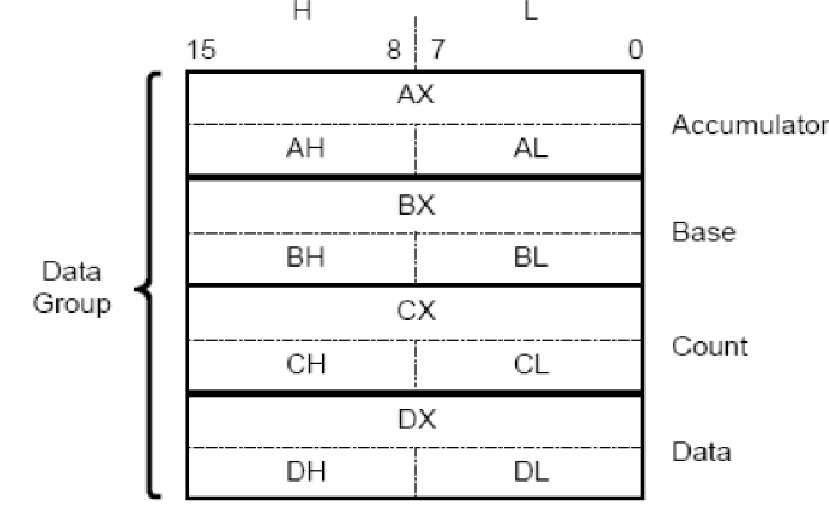
General-purpose registers: Abstract view
Specific roles of each register

Slide 7
General-purpose registers
Accumulator register
AL and AH, together as 16-bit AX
Mandatory for the multiplication and division operation
Used for I/O and string manipulations
Base register
BL and BH, together as 16-bit BX
General-purpose register
Used for the indirect addressing
Counter register
CL and CH, together as 16-bit CX
Used for storing the count values during loop operations
Data register
DL and DH, together as 16-bit DX
Used together with AX during the multiplication and division
A convenient place to store the data

Slide 8
Flag Register
16-bit register, 9 flags (6 conditional 3 control)
----------------------------Conditional flags-------------------------------------
Carry flag CF, bit 0 : set when a carry is generated during an arithmetic operation of unsigned numbers
Parity flag PF, bit 2 : set if the binary data has even number of 1s
Auxiliary carry flag AF, bit 4: set during BCD operations, not accessible to programmers

Slide 9
Flag Register (contd.)
Zero flag ZF, bit 6: set if the result is zero
Sign flag SF, bit 7: set if the result is negative
Overflow flag OF, bit 11: set if an overflow is detected during signed operation
------------------------Control Flags-----------------------------------------
Trap flag TF, bit 8: puts CPU to single step mode for debugging
Interrupt flag IF, bit 9: Interrupts are enabled when set
Direction flag DF, bit 10: used for string operation

Slide 10
Bus Interface Unit
Fetches instructions from the memory
Performs pipelining
Fetches 6 Instruction bytes and queues it while the EU is busy
Sends out 20-bit addresses to the memory
Memory is divided into 4 segments of 64KB
Code segment, Stack segment, Data segment and Extra segment
Provides a set of segment registers

Slide 11
Segment registers
Code Segment (CS) register
Stores the upper most 16-bit starting address of the code segment
Stack Segment (SS) register
Stores the upper most 16-bit starting address of the stack segment
Data Segment (DS) register
Stores the upper most 16-bit starting address of the data segment
Extra Segment (ES) register
Stores the upper most 16-bit starting address of the extra segment

Slide 12
Pointers and Index registers (16-bits)
Instruction Pointer (IP)
For CS register offset
Stack Pointer (SP)
For SS register offset (only the current top value of the stack)
Base Pointers (BP)
For SS register offset (anywhere up to the top of the stack)
Source Index (SI)
For pointing the source data in Data segment using DS register
Destination Index (DI)
For pointing the destination location to store data in Data segment using DS register

Slide 14
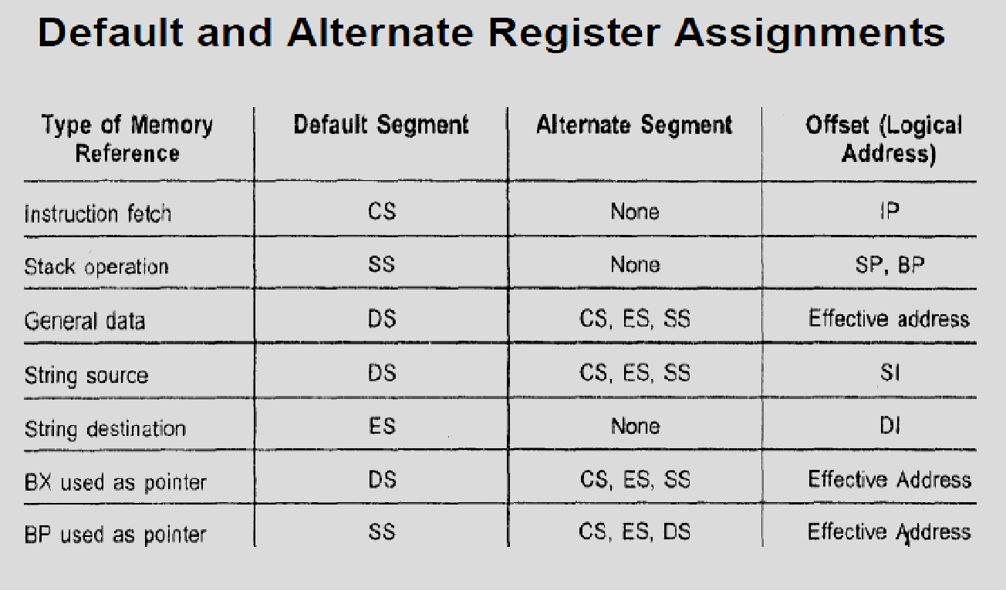

Slide 15
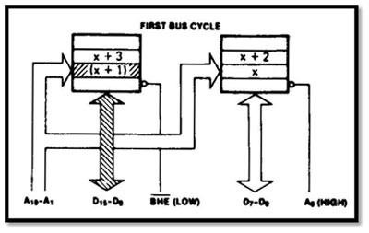

Slide 16
